Slide 1

Experimental Investigation and Analytical Modeling of Unsteady Vortex Flows
Dr. Juhi Chowdhury
Department of Mechanical and Aerospace Engineering
University at Buffalo

Slide 2
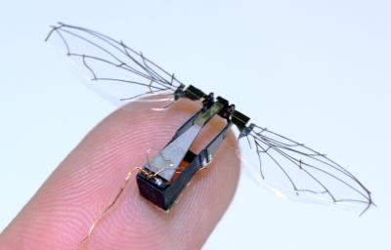
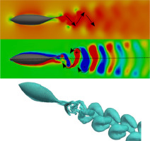
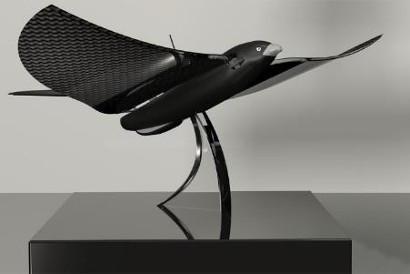
Unsteady Vortex Flows
MAV (Micro Air vehicle)
Bio propulsion
Aircraft Wing
Drone
Notes:
Why is the research in unsteady vortex flows important? An understanding of the vortical structures and vortex breakdown is essential for the development of highly maneuverable air vehicles. All these applications involve unsteady vortex flows and the design of these systems needs a good understanding of the flows.

Slide 3
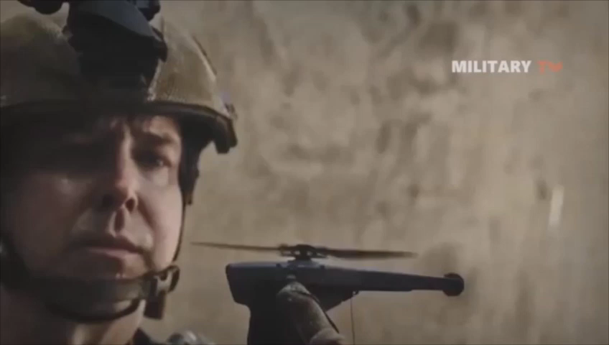
Application Area: Drones & MAVs
Rescue mission
Agriculture
Drones
&
MAVs
Deliveries
Research
Photography
Military
Military
Black hawk from Praxodynamics
MAV: Micro Air Vehicle
Desirable feature: Maneuverability
Notes:
What are drones useful for? Show video of a drone or micro air vehicle
Then show, how gust affects them

Slide 4
What if the drone is hit by a gust?
Can it survive?
Military
Military
Notes:
Fixed wings air vehicles have limited capability in this kind of extreme weather conditions.
For non-ideal atmospheric conditions, like gust, or maneuverability and agility, the wings may have to have complex motions or shape change.
For that, we can take inspiration from the nature…

Slide 5
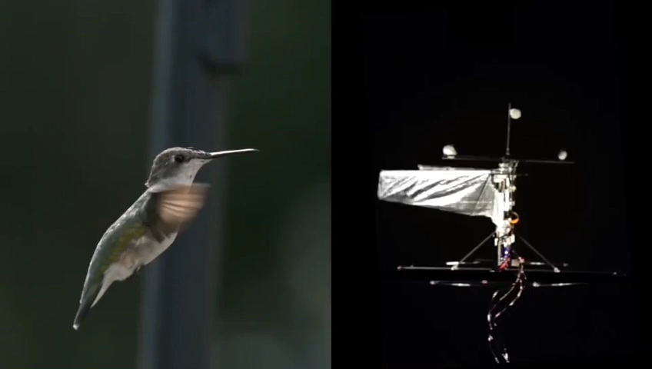
Motivation & Objective
Inspiration
from
nature
Ward-Smith 1984
Hubel et al, 2009
Notes:
like we see in various flying animals, such as, birds, bats, insects.
Their wings rotate, translate, pitch, fold, twist, bend…so many sophisticated features they showcase!
By understanding the -> aerodynamics of those techniques, we can improve the flight performance of drones and micro air vehicles.

Slide 6
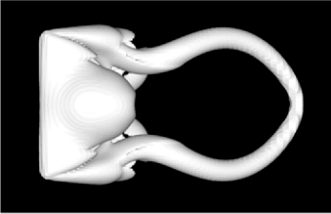
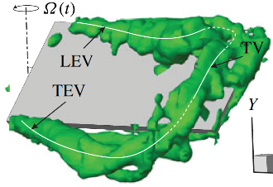


Motivation & Objective
Gust mitigation technique: varying wingtip geometry of a translating wing— rotating panel with aft sweep
Inspiration
from
nature
Ward-Smith 1984
chord
U_{main}
Translation, rotation, & sweep
Rectangular main wing
span
TV
LEV
Taira & Colonius,
JFM ’09
Rotating tip panel with aft sweep
chord
TV
α
Taira & Colonius, JFM ’09
Carr et al., JFM ’15
Periodic LEV shedding
Periodic lift changes
Attached LEV
Sustained lift
Attached LEV
Sustained lift
Notes:
->An important aerodynamic feature of this flight is flow separation due to high angle of attack. Here The flow separated and rolled up into a leading-edge vortex
that generates high lift but then sheds. But for small AR rotating wings, LEV stays attached, giving a sustained lift. If there is a sweep,
that promotes spanwise flow helping with LEV attachment .
Therefore by combining sweep and rotation, we can expect to change the vortex dynamics to our advantage in wing translation.
Our goal is to mitigate the gust effect by rotating a tip panel which also has a sweep and also learn how the vortex dynamics changes
.

Slide 7
Research techniques
Force measurement
Qualitative flow viz.
Quantitative flow study
Modeling
Notes:
I measured lift to study the effect of gust and gust recovery performance.
I used dye-flow visualization to study the flow qualitatively , then used 4D PTV to acquire in-depth knowledge of the vortex dominated flow to justify the lift variations.
Finally, a low order modeling will bring a nice closure to the study.
Since modeling this particular wing flow would be difficult, there is translation and rotation involved. I focused on a small part for modeling..that is the rotational component of the wing

Slide 8
Model for the Unsteady Lift of Rotating Wings
Objective: develop a 3D analytical model for unsteady rotating wings and compare it with available experimental and numerical results.
Application: mathematical models used for vehicle design, such as drones, and flight controller.
Chowdhury, J., & Ringuette, M. (2019). A simple vortex-loop-based model for unsteady rotating wings. Journal of Fluid Mechanics, 880, 1020-1035
Notes:
Since our group performed experiments on rotating wings in the past, I already had data available to work on a model and compare against those data.
This type of modeling is important for aerodynamic and control system design for bio-inspired drones.
But such efforts have often been limited to being two-dimensional, semi-empirical, sometimes computationally expensive, or quasi-steady.
The current model is unsteady and three-dimensional, yet simple to implement.

Slide 9
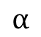
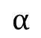
Model Assumptions
Wing schematic & 3D vortex loop
Loop is tilted
Growing vortex loop
LEV
b = span
c = chord
RV
$$α$$
$$α$$
TV
AR=4 simulation from Jardin & Colonius (2018)
TEV
AR=2 exp. from Carr et al. (2015)
The model assumes a coherent planar vortex loop structure: LEV-TV-TEV-RV
Notes:
Rotating wings produce a vortex loop consisting of
-> the root vortex, -> leading-edge vortex, -> trailing-edge vortex, and –> tip vortex.
The trailing edge vortex remains where the motion starts.
The leading edge vortex stays attached to the wing.
The loop grows as the rotation angle increases,
therefore also in time.
->This is modelled as a tilted planar loop,
geometrically specified by the wing size, orientation and motion.
What I mean by orientation is that the loop has an angle theta
w.r.t the horizontal plane, -> which is different from the angle of attack.
In reality, the rotating wing flow is very complex and 3D.
There are a lot of details in the structures,
but we take advantage of the coherent loop structure and simplify the problem.

Slide 10
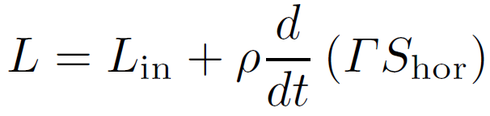
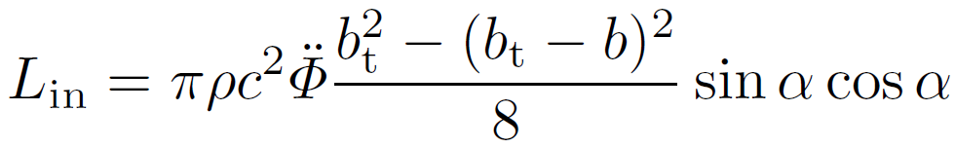
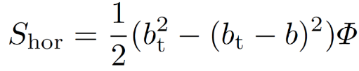
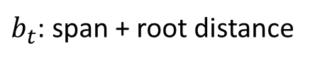
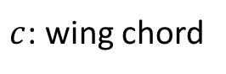
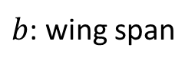
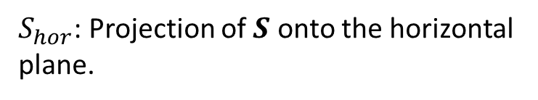
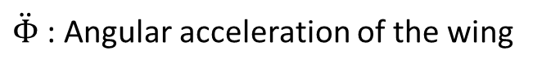
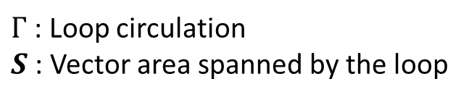

Basic Framework
$ρ$: fluid density
$c$: wing chord
Total lift:
$\ddot{Φ}$ : Angular acceleration of the wing
Inertial
Circulatory
$b$: wing span
$b_{t}$: span + root distance
α: Angle-of-attack
Inertial Lift:
$Γ$: Loop circulation
$S$ : Vector area spanned by the loop
(Potential flow, blade element: Percin & van Oudheusden, 2015)
$S_{hor}$: Projection of $S$ onto the horizontal plane.
Notes:
-> There are two main contributions to the lift force on the wing:
->inertial lift… which is present during the wing acceleration. When the wing accelerates, it accelerates the fluid surrounding it.
-> That accelerating fluid gives force to the wing which is called the inertial force. Inertial lift can be calculated simply using potential flow theory. It includes wing kinematic and geometric parameters that are known to us already.
-> 2nd contribution to the lift is the vortex force or circulatory force. Modeling circulatory force is challenging.
To find circulatory force, I need -> the loop circulation,
and loop area on the horizontal plane,
which is given by -> this formula. Phi is angle of rotation.

Slide 11
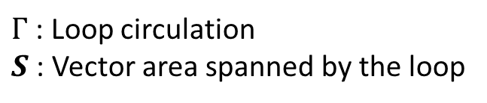
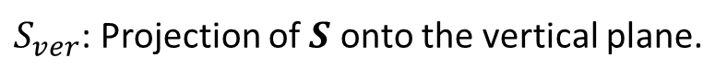
Basic Framework
Total lift:
$Γ$: Loop circulation
$S$ : Vector area spanned by the loop
Circulatory
$S_{ver}$: Projection of $S$ onto the vertical plane.
Sullivan et al. (2008) showed that the momentum of the volume of fluid displaced by a piston is approximately equal to the impulse of vortex ring.
Approximate fluid mass displaced by the wing:
Impulse of thin vortex loop:
Running mean of rotational speed:
Radius of gyration:
Angular momentum of the volume of fluid displaced by the motion of the wing.
Angular impulse of the vortex loop about the axis of rotation.
Notes:
Sullivan et al. showed that …the momentum of the volume of fluid displaced by a piston ….
is approximately equal ….
to the impulse of the vortex ring generated by the piston motion.
The impulse of a thin -> 3D vortex loop can be found from this relation.
Drawing an analogy to the rotating wing-flow ->…..
I equated the -> angular momentum of the volume of fluid
displaced by the motion of the wing….
-> to the angular impulse of the vortex loop….about the axis of rotation.
Definition of each symbol is given on the right.
Two things are unknown in the momentum balance equation:
-> the loop circulation and ->the loop area
-> projected onto the vertical plane.

Slide 12
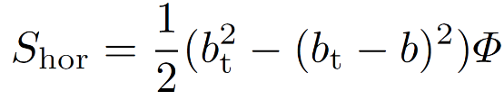
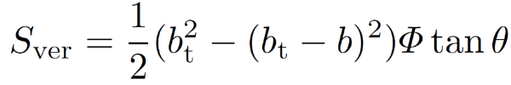
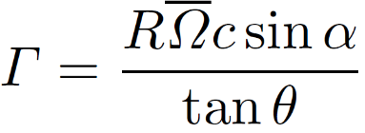
Basic Framework
Schematic of loop on the horizontal plane
b
Notes:
->From the planar loop geometry, S vertical -> can be expressed as this.
Once S_vertical is ->substituted in the momentum balance,
we get a -> simplified form for the loop circulation.
So essentially it becomes a problem of finding the loop angle, theta.

Slide 13
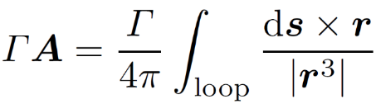
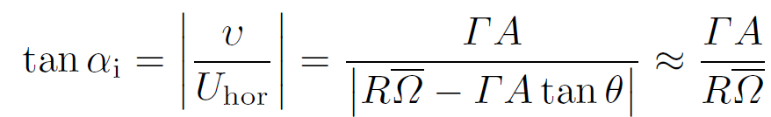
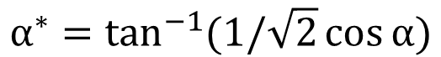
Finding Loop-angle θ
Total lift:
Downwash
Modified angle-of-attack
Biot-Savart Law:
Induced angle
&
Induced angle:
α scaled by near-wake flow:
$$α^{∗}=\tan^{−1}{(1/\sqrt{2}\cos{α)}}$$
Notes:
Finding the loop angle was challenging as the loop structure is very much three dimensional.
In the interest of time, I will skip the details. But..briefly…
I used the concept of ->
modified angle of attack by the near wake flow ….
-> and downwash,
-> to find tan theta.
Everything in this term is known from either geometry or kinematics.
Therefore -> plugging all these, lift can be found.

Slide 14
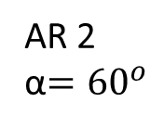
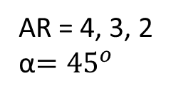
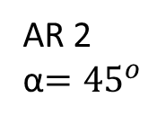
Unsteady lift comparisons
AR 2
α$={45}^{o}$
AR = 4, 3, 2
α$={45}^{o}$
----- Model
Experiment/simulation
Motion Profiles
Good trend match.
Within 18% deviation during wing’s steady motion.
Within 20% deviation for mean lift, for some cases, below 10%.
AR 2
α$={60}^{o}$
Notes:
I took a variety of cases from different research groups to compare my model with…
for example, UB2 3 4 are the experimental results from our group.
The others are: TU Delft, UMD, RVC, and AFRL.
->They have different ARs, Reynolds numbers, root cutouts,
-> and accelerations.
In the motion profiles, you can see that the wing at first accelerates
over certain rotation angles,
then rotates at a constant angular velocity.
For the force plots, X axis is angle of rotation….
that is representative of time,
and y axis is lift co-efficient.
In general the lift trend has a peak due to acceleration,
and then over time saturates.
There is -> overall good agreement.
->The model reasonably predicts lift co-efficient ….
within 18% of the experimental results during the wing’s steady motion.
And the trend is also captured well.
It is not always effective at capturing -> the startup-acceleration peak,
and the deviation is more than 20% of the experimental results.
However, -> it gives a reasonable estimate of the peak
when compared with the numerical simulation.
For mean lift, -> the deviation is within 20%,
for some cases it is below 10%.

Slide 15
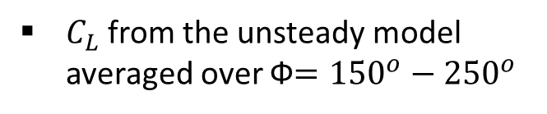
Steady lift comparisons
Steady-state form of the model:
$C_{L}$from the unsteady model averaged over Ф$={150}^{o}−{250}^{o}$
Excellent agreement with the experiment over a range of angles-of-attack
Notes:
After unsteady lift comparison, let’s look at steady lift comparisons.
Dickinson et al. measured the steady lift for a robotic fruit-fly wing …..rotating from rest ….for angles of attack ranging from 0 to 90.
I used a rectangular geometry, but matched the wing area and Rossby number for my model.
I compared two things with Dickinson’s experimental results:
-> I mathematically derived a stead-state equation …from the unsteady model I talked about earlier….solid line shows the steady state model. And also the formula is very simple.
I took another approach: -> I averaged the CL from the unsteady model… over 150 degrees to 250 degrees of rotation angle. It’s shown with asterisk symbol on the plot.
The both approaches have an excellent match with the experimental data.

Slide 16
Wings experiencing gusts
Gust velocity, V
U
Greenblatt et al., 2016
t
U
U
t
Chowdhury & Ringuette, 2020
t
Andreu-Angulo et al., 2020
Longitudinal/Streamwise gust
Transverse gust
U
Zaloglu et al., 2020
Vortex gust
Notes:
Now let’s go back to the gust mitigation problem. Recently many researchers have been looking into various kinds of gust responses… in attached or separated flows, particularly the researchers in the NATO AVT group.
->Two common types of transverse gust are shown in the picture…..
gust velocity as a square wave function ,
and another is a sine-squared variation.
-> A wing can also experience vortex gusts.
->We are experimenting with streamwise gusts: we are using step velocity functions….
->another group is looking into periodic streamwise gusts.
At first researchers are trying to understand the gust effects and then exploring gust mitigation potential of flapping wings.

Slide 17
Approach
Execute streamwise step-up and step-down gusts in water towing tank at 21c traveled.
Gust:
amplitude = 0.5U_{main,initial}
width = 1c
Step-up gust
Step-down gust
Re=9K
U
Re=10K
Re=6K
U
Re=5K
Notes:
Speaking of gust mitigation, we particularly focused on streamwise gust…streamwise gust means there is a sudden increase or decrease in velocity in the streamwise direction.
For our case, we increase the speed by 50% for stepup and decrease the same amount for stepdown, over 1 chord distance during wing’s travel.
The gust starts at 21 chords distance from the start of the wing motion.
You can see the Reynolds number changes here.

Slide 18
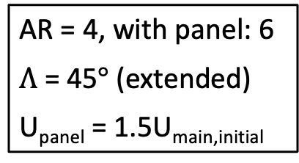
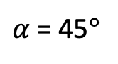
Approach
Wing model
Execute streamwise step-up and step-down gusts in water towing tank at 21c traveled.
Parameters
Gust:
amplitude = 0.5U_{main,initial}
width = 1c
DC motor for tip motion
Step-up gust
Step-down gust
Control rod
Re=9K
U
Re=10K
c
Re=6K
U
Re=5K
U_{main}
𝛬
Λ
U_{panel}
U
U
AR = 4, with panel: 6
$Λ$ = 45$°$ (extended)
U_{panel} = 1.5U_{main,initial}
chord
Actuation-in,
Staticsweep -> rectangular
Actuation-out,
Rectangular -> staticsweep
$α$ = 45$°$
*Chowdhury, J. & Ringuette, J. M., AIAA J, 2021
Notes:
For step-up gust, the wing starts out with the panel extended..calling that “static sweep” , then after actuating the tip inward it becomes a rectangular shape.
The opposite is true for stepdown. Starts out as a rectangular wing, then after actuating the tip outward, becomes staticsweep.
For both cases actuation occurs at 21.5 chords.
Here are the parameters: AR 4 for rectangular shape, 6 with the panel extended. Angle of attack 45 deg., sweep angle 45 when extended.

Slide 19
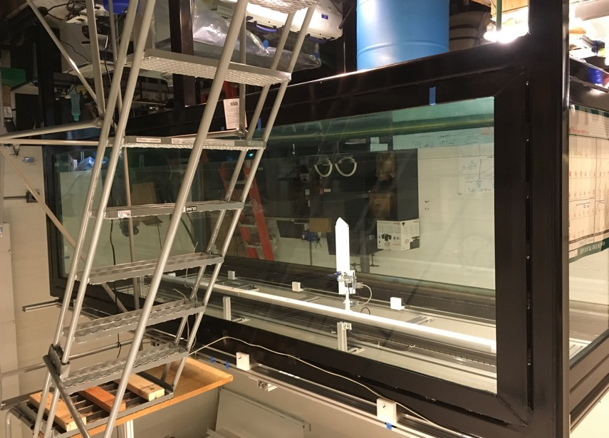
Experimental setup: towing tank and wing
Linear motor
DC motor for tip motion
Motor arm
Control rod
Wing
c
Rect. main wing
Planform view
b
Towing tank (not filled)
U_{main}
𝛬
Rotating tip panel
Pivot
Λ
U_{panel}
4m x 1.5m x 1.1m glass-walled water towing tank, 3m H2W linear stage.
~1/8-circle tip panel rotates via a pivot, fully-retractable inside wing.
Panel driven by DC servomotor + arm, via control rod through inside of wing.
ATI Gamma transducer is used for force measurements.
Notes:
Here’s the experimental facility.
->We installed a 3m long linear stage on this glass water tank.
->The wing is suspended vertically from the linear stage.
->The rectangular flat plate wing has a tip panel attached via pivot at the wing tip.
That panel can be rotated in and out of the wing…
-> using a control rod that goes through the inside of the wing.
The other end of it is attached to a motor arm.
This motor and the linear stage work in sync
with the help of a programmable controller.
At the base of the wing, there is a transducer that measures forces.

Slide 20
Experimental setup: dye visualization
Aft-view camera
Neutrally buoyant dye through gravity-feed system.
Dye ports: along LE, at TE corner (internal); along tip aft of pivot (external).
3 orthogonal HD cameras; white lighting against white backgrounds.
Top-view camera
End-view camera
Not to scale
Notes:
For dye viz experiments,
I used white backgrounds and white paint on the wing for better contrast.
->On the right, you can see a closeup view of the wing.
3 dye tubes are internally embedded and one is externally attached.
-> These tubes feed dye to the points of interest.
The neutrally buoyant dye is prepared in-house.
The dye is delivered through the gravity feed system.
->3 orthogonal camera views were captured to have a better visualization of the flow.

Slide 21
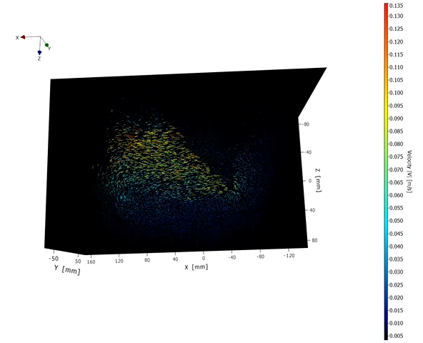
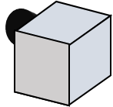
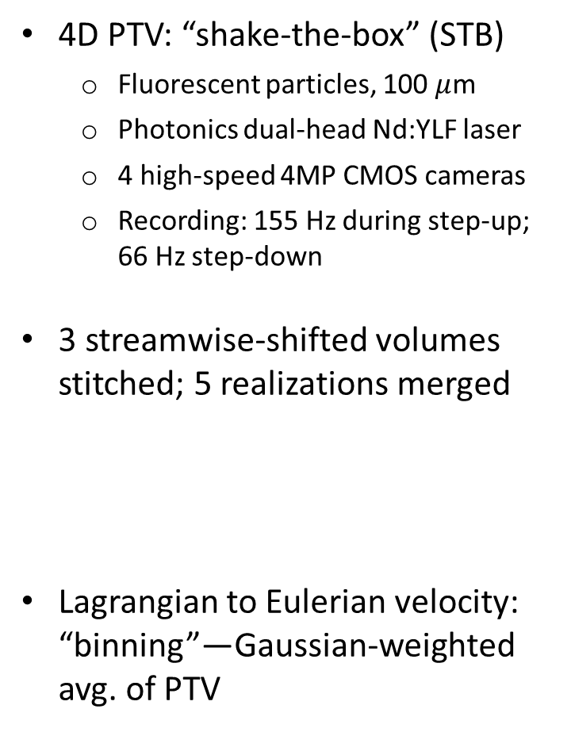
Experimental setup: Particle Tracking Velocimetry
4D PTV: “shake-the-box” (STB)
Fluorescent particles, 100 $μ$m
Photonics dual-head Nd:YLF laser
4 high-speed 4MP CMOS cameras
Recording: 155 Hz during step-up; 66 Hz step-down
3 streamwise-shifted volumes stitched; 5 realizations merged
Lagrangian to Eulerian velocity: “binning”—Gaussian-weighted avg. of PTV
Tow direction
Wing
Y
Z
X
Dual-head laser
*Not to scale

Slide 22
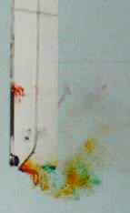
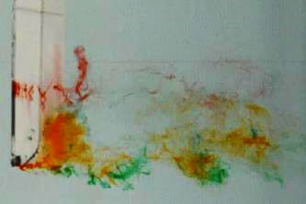


Effect of Gusts on a Rectangular wing
Step-up gusts
Step-down gusts
Gust start
1c ends
3c ends
6c ends
End view
Top view
shed LEV
End view
Top view
LEV
new LEV
TEV
TV
TEV
TV
Notes:
Two different gust types…..step up and step down…
then each has 3 types of ramps….1chord ->….1chord means distance traveled by the wing of length 1 chord…..then, 3chords -> and 6chords.
Force plots are at the top….and some dye visualization pictures are shown at the bottom.
Step-up 1c ramp has the highest added-mass dominated peak, and 2 distinct circ.-force peaks.
The 2nd peak is present for 3c ramp but not for 6c.
Those circulatory lift peaks are due to the formation of LEVs. When the LEV sheds there’s a drop in lift.
Trailing edge vortices also form and shed.
Step-down: has C_{L} < 0 added-mass contribution—during wing deceleration for 1c ramp.
It is due to the -> prior wake impingement or interaction with the wing. Impinging wake disrupts the tip vortex flow.
See how the wake here looks different from the stepup case. The wake is wider in the span and chordwise direction.
The LE shear layer is deflected upward. The overall wake angle increases dramatically, which could explain the lift force drop.
But finally the CL recovers to a circ. peak for all cases.

Slide 23
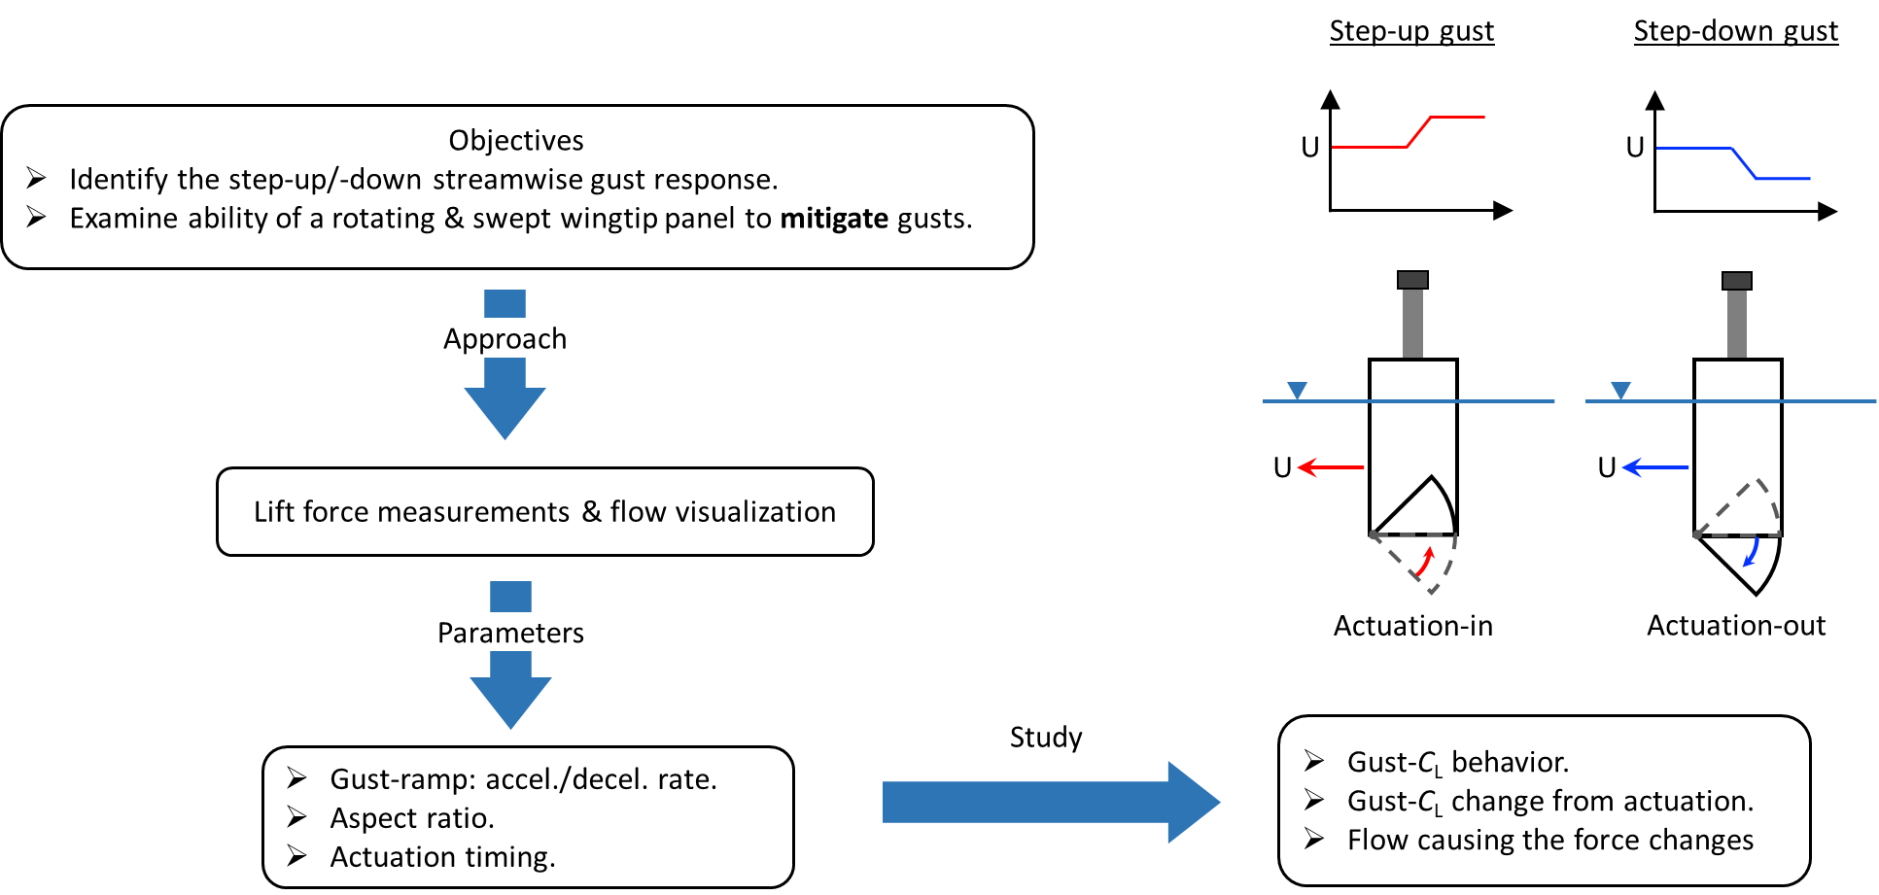
Step-up gust mitigation: tip actuation in
U
Static sweep
U
Rectangular
Notes:
Now, I am gonna talk about the step-up gust and the effects of actuating the tip inward.
The wing started out with -> a sweep, then while going through the step-up gust,
-> the tip is actuated inward and therefore the wing attains a rectangular shape. ->

Slide 24
Step-up gust: tip actuation in
AR=4
1c ramp
3c ramp
6c ramp
AR=2
Notes:
These are all lift co-efficient plots against the number of chords traveled. The top row is for AR4, and the bottom is for AR2.
Earlier we saw that without a gust, the lift-coefficient CL should be flat after about 20 chords traveled
notice the dashed gray….
but due to the step-up gust, the lift co-efficient increases,
Although this amount of increase varies with gust ramp distances
and also aspect ratios as you can see here.
So our aim is to bring the lift co-efficient down, closer to the flat curve.
To achieve that, the tip panel is actuated inward during the gust.
->Here we compare the actuation effects with its pre- and post-gust shapes,
i.e. the rectangular (dashed black lines) and static sweep (dotted lines).
Out of the two actuation timings that I considered,
the early actuation, i.e. 21.5c actuation lowers gust peak for 3c and 6c ramps,
-> whereas 50% actuation has more prolonged benefit.
For 1c ramp, 21.5c actuation is the 50% actuation.
Though the gust peak is unaffected, the actuation reduces the gust force significantly afterward in a sustained manner.
And more so for AR 2.

Slide 25
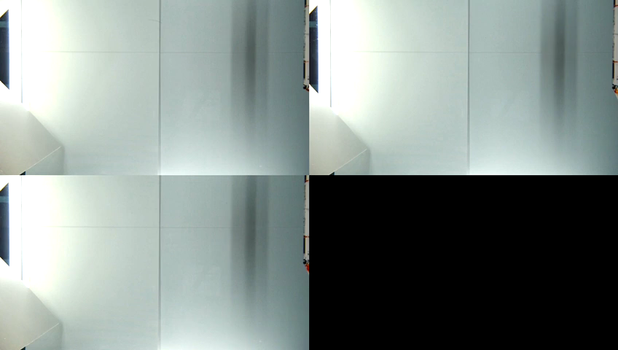
Rectangular
Static sweep
Step-up gust
Actuation-in

Slide 26
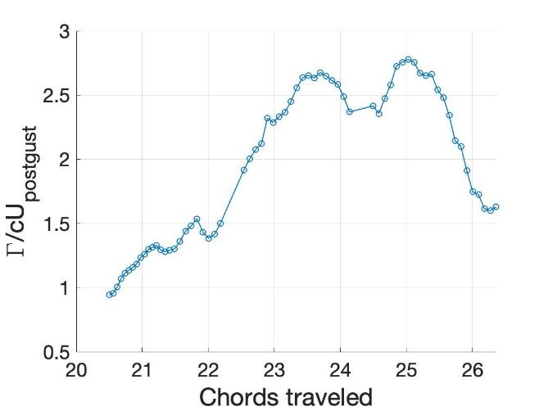
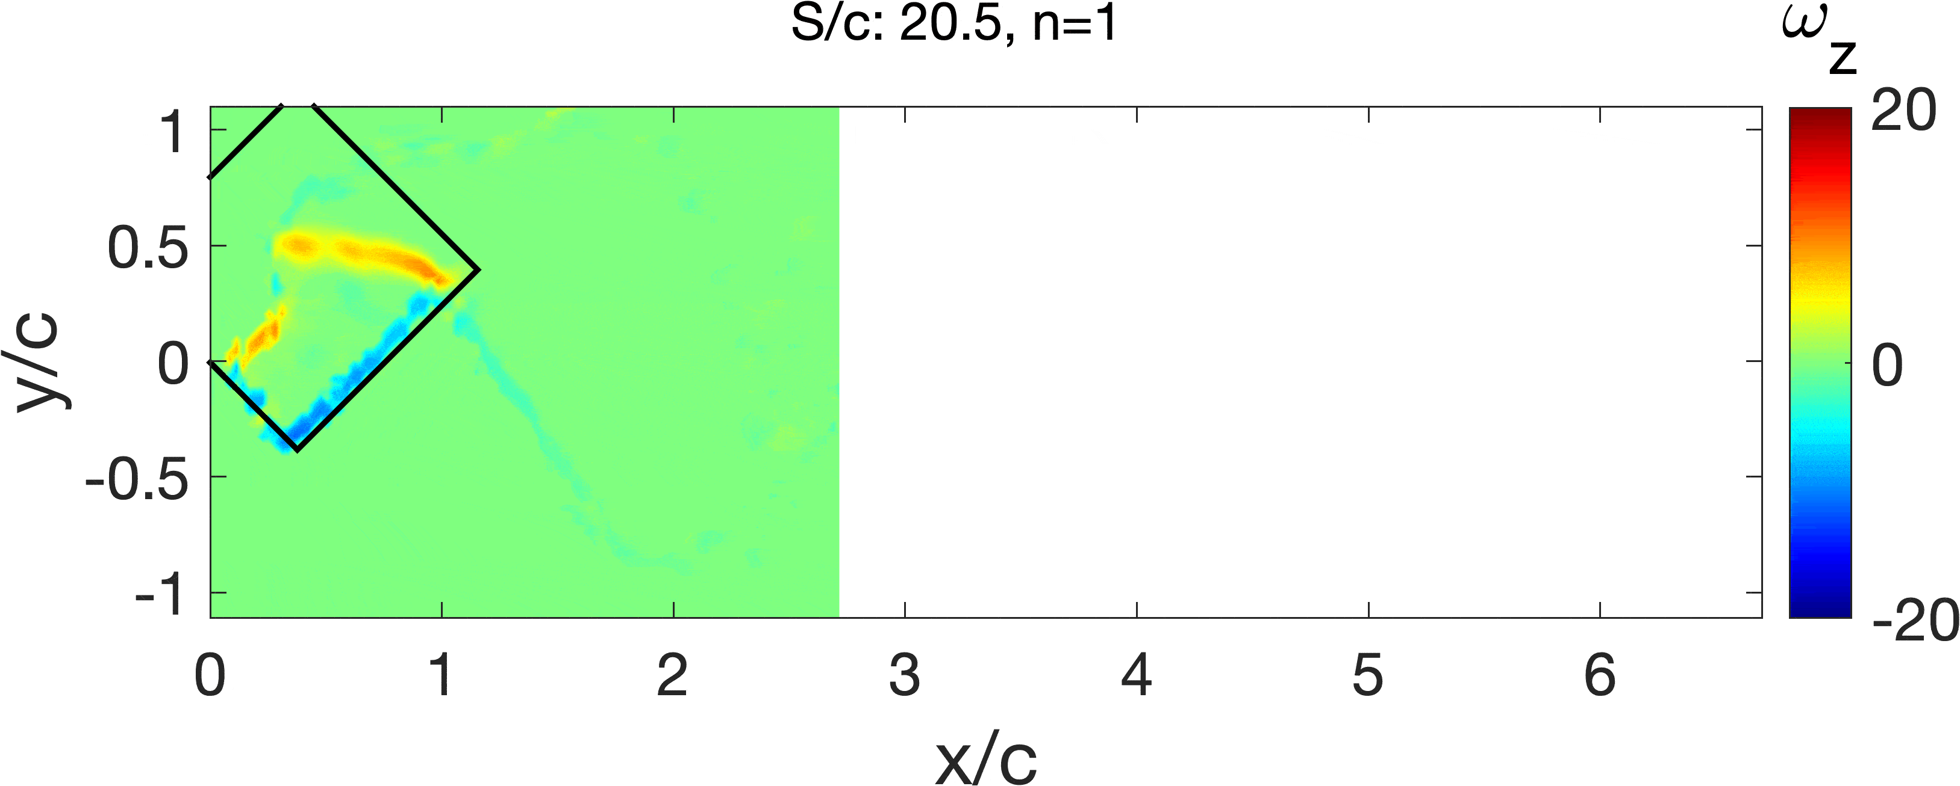
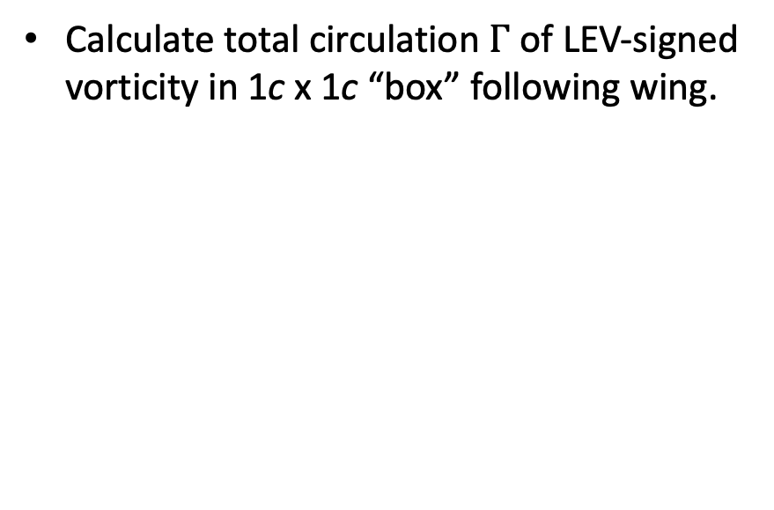
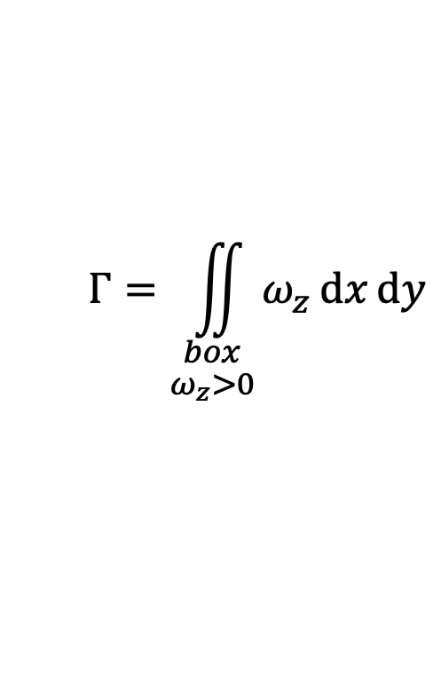
Total circulation in chordwise (const.-span) planes
Calculate total circulation $Γ$ of LEV-signed vorticity in 1c x 1c “box” following wing.
b = span
$$Γ=\iint_{\begin{aligned}box \\ ω_{z}>0\end{aligned}}{ω_{z}ⅆxⅆy}$$
b
0.75b
Rectangular step-up gust
Notes:
To study the differences in flowfield for the two types of gusts and also variation in wing shapes, today we will focus on total positive circulation near the wing.
It is calculated using the positive spanwise vorticity, omega_z in the 1c by 1c square region as indicated by the black box using that formula. The positive ωz is contained in the LEV and the negative in the TEV.
The plot on the right hand side shows total positive circulation calculated in the box, vs chords distance traveled by the wing.
The box moves with the wing as it translates. Essentially, the box contains all LEVs that are close to the wing, and are likely to contribute to the lift force on the wing.

Slide 27
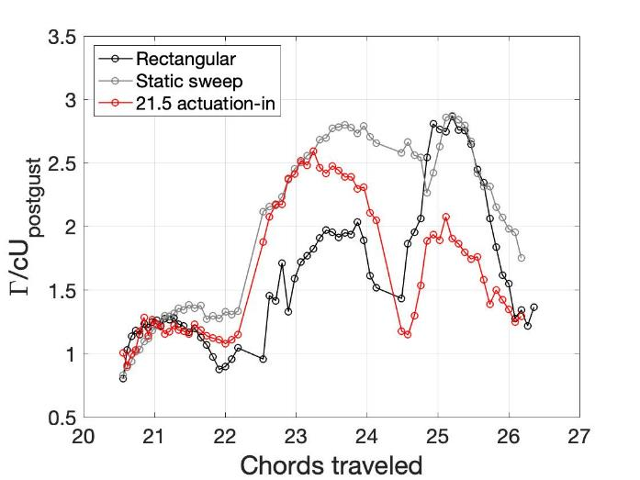
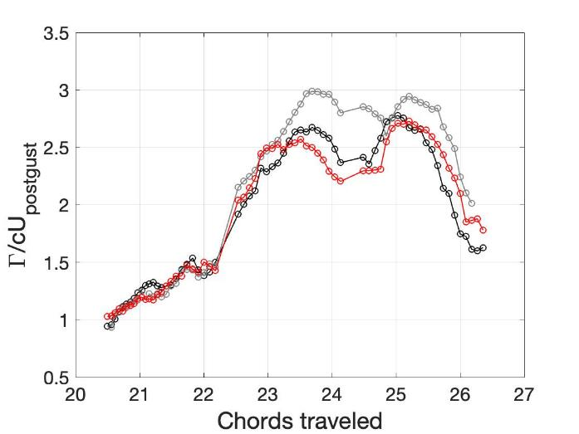
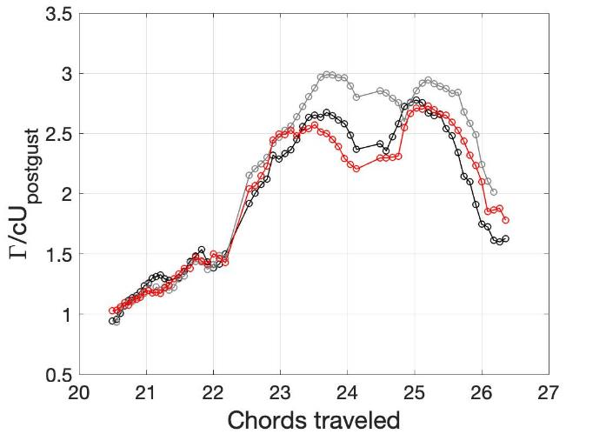
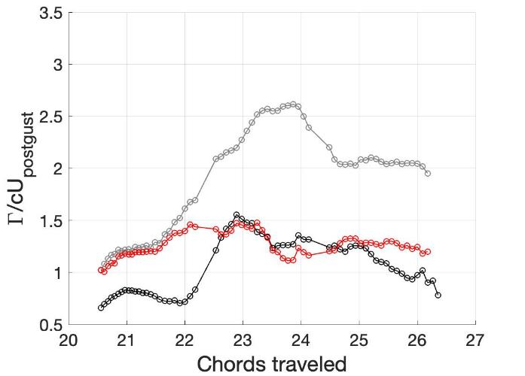
Total circulation for step-up gust
b
0.65b
0.75b
0.90b
65% span
75% span
1.05b
b = span
105% span
90% span
Notes:
Here we compare 21.5c actuation-in with the rectangular and staticsweep cases for step-up gust in terms of total positive circulation near the wing. Since the staticsweep and rectangular shapes are basically the pre and post actuation shapes for the actuation-in case, so this comparison helps identify the dynamic changes in the important flow quantities such as circulation from that of the static wing shapes.
Since this is a planar treatment, different spanwise locations are chosen: we have 65%, 75%, 90%, and 105%.
Overall the total circulation for the static sweep is higher than rectangular case in some parts of the wing travel after the gust.
Before actuation, that is before 21.5c traveled, , static sweep & actuation-in cases are similar as expected.
Then actuation-in eventually drops to the rectangular level, and in some cases even lower than the rectangular wing, ….especially for 65% span, even though the wing attained the same rectangular shape after the actuation.
These effects are reflected in the lift-coefficient.
Another thing to notice is the the total circulation for actuation-in case starts to deviate from that of the static sweep earlier outboard, such as at 105% span, later inboard as expected.

Slide 28
Step-down gust mitigation: tip actuation out
U
Rectangular
U
Static sweep
Notes:
Now, I’ll explain about the step-down gust and effects of actuating the tip outward. ->
The wing started out with a rectangular shape, then while going through the step-down gust,
-> the tip is actuated outward and therefore the wing resembles the shape of the static sweep case. ->

Slide 29
Step-down gust: tip actuation out
AR=4
1c ramp
3c ramp
6c ramp
AR=2
Notes:
Stepdown gust is basically slowing down. Therefore, we observed that the wing loses lift based on the gust ramps.
For the gust mitigation purpose, we have to produce more lift to fill the gap.
So the tip is rotated outward during the gust.
->And we do achieve lift boost by doing so…as you can see the red curves are higher than the rectangular and static sweep cases overall.
21.5c actuation seems a bit too early for 3c and 6c ramps to alter the gust force.
-> 50% actuation also reduces the lift drop significantly for all cases.
Actuation is more effective in mitigating gust for AR=2 …as expected because of greater planform change.
One strange thing is though that the wing starts out as a rectangular wing and takes the shape of static sweep after actuating outward,
…..But post-gust actuation CL is closer to the rectangular wing than the static sweep case.
As a future work, after I process the static sweep PTV data, I may find some answers there.

Slide 30
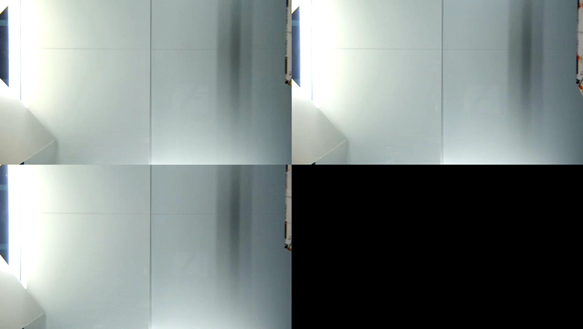
Rectangular
Static sweep
Step-down gust
Actuation-out

Slide 31
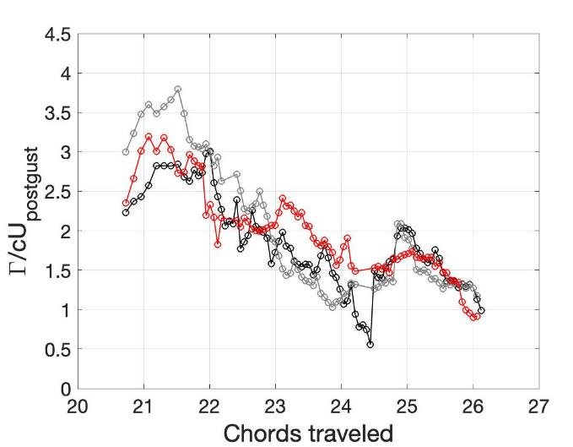







Total circulation for step-down gust
Rectangular case,
65% span
75% span
90% span
105% span
115% span
130% span
Notes:
For stepdown gust, the total circulation decreases with chords travel. It could be partly because the vortices are leaving the box where I calculate the total circulation as you can see in this movie. Due to slowing down, the LEVs rapidly shed. For 115% and 130% span, the red curve goes up that is because, the tip panel has been actuated out, so there’s a new surface where new vorticities will be created. That definitely helps this case to overcome some loss.
Also, overall, in places, the red curve is higher than both the rectangular and static sweep cases, especially for inboard locations.

Slide 32


Takeaways
Inward tip actuation can mitigate the gust-impulse change by as much as 38% and outward tip actuation by 84%. Effects are present even when wing area & velocity changes accounted for.
Actuation-in reduces $Γ$ over much of span—coincides with lower $C_{L}$.
For actuation-out, $Γ$ is sustained above static cases across much of the span—coincides with higher $C_{L}$ plateau before all cases recover.
In most cases, actuation yields better gust-force change for AR=2 than 4, due to the greater change in wing planform.
Actuation timing and ramp distances also play a role.
Chowdhury, J. and Ringuette, J. M., “Effect of a Rotating and Swept Wingtip on Streamwise Gust Alleviation”, AIAA J, 2021
Acknowledgments
National Science Foundation (Award # CBET-1706453) supervised by Dr. Ronald Joslin, and award no. CBET-1828544 (MRI Program), supervised by Dr. Shahab Shojaei-Zadeh.
Prof. Matthew Ringuette, Karan Shah, Adam Hammond.

Slide 33


Fluid-Structure Interactions in Face Masks
Center for Fluid Mechanics
Brown University
Collaborators: Kenny Breuer, Rajat Mittal, Kourosh Shoele, Erin Tucker, Jay-Young Cho

Slide 34

Motivation & Objective
Background
Face masks reduce the spread of airborne diseases
Lack of understanding of fundamental material and mechanical properties of masks
Goal of the Study
Air permeability over a range of flow rates
Mechanical deformation of masks due to pressure drop
Notes:
Go back to renaming “airborne virus”
Touch upon how masks are designed based on both filtration efficiency and breathability
Researchers touched upon both medical and home made masks. Aydin also looked into breathability
Exploring material properties of masks and various clothes that can be used to make masks. How the material property changes with # layers and

Slide 35

Parameter Selection
Respiratory flow velocities:
Recommended pressure drops (in Pa) across a face mask
Chosen range of parameters in experiment
 | At rest | Light exercise | Moderate Exercise | Intense Exercise
³Flow rate (L/min)/ Velocity (m/s) | 85/0.67 | 100.3/0.79 | 150.1/1.2 | 218.4/1.7
 | ¹Resting | ²Speaking | ¹Sneezing | ²Coughing
Male/Female (m/s) | 1.0/1.0 | 4.1/2.3 | 50/50 | 15.4/10.6
v_{mouth}
Velocity based on 0.048 m of exit diameter of a human mouth
v_{mask}
V_{mask}< v_{mouth}
NIOSH⁴ | WHO⁵
< 245 (exhalation), < 343 (inhalation) | < 100
[1] Xie et al., PubMed, 2017. [2] Kwon et al., Chemosphere, 2012. [3] Andersen et al., JISRP, 2007. [4] NIOSH 2019. [5] Advice on the use of masks in the context of COVID-19: Interim guidance, WHO, 2020.
Flow Rate (SLPM) | Pressure (Pa)
0 – 100 | 0 - 600
Notes:
NIOSH “Guidelines”; WHO “Recommendations”
NIOSH – mention what it is; NIOSH has protocols on testing masks ; certify the masks
Our range: Relevant to physiological velocity and recommend pressure

Slide 36
Schematic of the Experimental Setup
Laser Displacement Sensor
Parameters
Temperature | 20 – 25 °C
Relative Humidity | 30 – 60 %
Flow rate | 0 – 100 SLPM
Differential pressure (across mask) | 0 – 600 Pa
Mask Material
Laser Beam
Pressure Transducer
Mask
Material
Airflow
3D Printed Ring
h
R
Mask material deflection
Air Chamber
Flowmeter
Needle Valve
Pressure Regulator
Pressurized air
from the wall
Airflow

Slide 37



Darcy’s Law for airflow through masks
For Re < 10 :
For Re > 10, the inertial term (Forchheimer term) is added.
Material thickness is very small. The final form:
$\frac{∂P}{∂x}$ | Pressure change across the mask/fabric thickness
$$v$$ | Airflow velocity
$$k$$ | Permeability of the medium
$$k_{i}$$ | Inertial permeability of the medium
$$\frac{∂P}{∂x}=−\frac{μ}{k}v−\frac{ρ}{k_{i}}v^{2}$$
$$\frac{∂P}{∂x}=−\frac{μ}{k}v$$
$$∆P=−\frac{μ}{k^{′}}v−\frac{ρ}{k_{i}^{′}}v^{2} or ∆P=−C_{k^{′}}v−C_{k_{i}^{′}}v^{2}$$

Slide 38


Comparison with available research data
$k′$: | Permeability of the material
Aydin et al., Extreme Mechanics Letters, 2020.
Rengasamy et al., Ann. Occup. Hyg., 2010.
Zangmeister et al., ACS Nano, 2020
*All data are for a single layer material.
Notes:
Used log scale so that the chiffon doesn’t appear too high making all other data overlap at very small values.
Our data seem to be slightly higher than the literature values, but also we went through

Slide 39




Permeability of multiple fabric layers
Various symbols represent different samples of the same mask/fabric type from the same manufacturer.
$$k_{n}^{′}=\frac{k_{1}^{′}}{n}$$
$k_{n}^{′}$ : permeability of $n$ layers of mask material with thickness ignored
Notes:
No research exists currently which investigates permeability in multi-layer masks
This is a very prominent finding in the context of mask manufacturing.

Slide 40








Mask material deflection under pressure
High thread count cotton
Airflow
$1/ψ$ = 0.008 m³.Pa
h
R
h : Deflection
R : radius
$1/ψ$ = 0.036 m³.Pa
Small membrane deflection ^{[1]} (h < t/5)
$$h=\frac{0.1875\left(1−ν^{2}\right)}{Et^{3}}R^{4}∆P$$
Large membrane deflection¹ (t/5 < h <3t)
$h= \sqrt[3]{−\frac{β}{2}+γ}+\sqrt[3]{−\frac{β}{2}−γ}$.
$β=∆Pf\left(R, E,ν,t\right)$, $γ=g\left(ε_{i}, R,ν,t,β\right)$
$h$: Maximum deflection
$E$: Elastic modulus
$ν$: Poisson’s ratio
$ε_{i}$: Initial strain
$t$: Thickness
$$ψ$$
[1] Eaton et al., MSM 99
Notes:
The plot has old data.

Slide 41



Structural property of mask materials
Thin plate small deflection (h < t/5),
$$h=\frac{0.1875\left(1−ν^{2}\right)}{Et^{3}}R^{4}∆P$$
$$ψ$$

Slide 42
Summary
Analyzed permeability coefficients under a range of flow velocities using Darcy’s Law
Found air permeability and its hyperbolic relationship to number of layers for various kinds of mask materials
Investigated structural property related to elastic modulus from the variation of mask material deflection with pressure change
Future Work
Effects of humidity, higher velocity, and unsteadiness (transient) on material and mechanical properties
Flow visualization to investigate flow through mask and gaps
Acknowledgments
Thanks to the sponsor, National Science Foundation, and Ben Lyons (Brown University), Prof. Kourosh Shoele (FSU) and Prof. Rajat Mittal (JHU)
Notes:
1/k or Ck is additive, not k
Ben Lyons for providing help with experimental tools
“Enlightening discussion on this topic”

Slide 43
Thank you
Questions ?

Slide 45






How important is the inertial term?
$$∆P=−C_{k^{′}}v(1+v\frac{C_{k_{i}^{′}}}{C_{k^{′}}})$$
Modified Darcy’s law:
$C_{k^{′}}$ = 754 Pa*s/m
k’ = 2.43E-08 m
$C_{k^{′}}$ = 8 Pa*s/m
k’ = 2E-06 m
The data are for a single layer material.
Notes:
2 sample, extreme cases

Slide 46
Rectangular plate with a swept rotating tip experiencing streamwise gust
Step-up gust
Step-down gust
Objectives
Identify the step-up/-down streamwise gust response.
Examine ability of a rotating & swept wingtip panel to mitigate gusts.
U
U
Approach
U
U
Lift force measurements, dye visualization, tomographic Particle Tracking Velocimetry (PTV)
Parameters
Actuation-in
Actuation-out
Study
Gust-C_{L} behavior.
Gust-C_{L} change from actuation.
Flow causing the force changes
Gust-ramp: accel./decel. rate.
Aspect ratio.
Actuation timing.

Slide 47



Experimental setup: force meas. & parameters
Step-up
Step-down
Force measurements
ATI Gamma sensor above wing.
1 kHz sampling; average 10 runs; subtract off results from air runs.
Low-pass filter to remove mechanical vibrations.
Re = 9k
Re = 18k
C_{L}
Re = 12k
Re = 18k
Time-avg. $δC_{L}:$ ±4%
$δC_{L}:$ ±6.7%
Chords traveled
Chords traveled
Parameters
Main-wing speed: U_{main}, Re O(10⁴).
α = 45$°;$ panel sweep angle: Λ = 45$°$.
AR_{eff,rect} = 2, 4 (Λ = 90$°$); AR_{rect+panel} = 4.1, 6 (Λ = 45$°$).
Extended (Λ = 45$°$) panel area: 31.7%, 15.8% of main wing.
Panel tip speed: U_{panel} = 1.5U_{main, initial}.
c
b
U_{main}
𝛬
Λ
U_{panel}

Slide 48


Rectangular wing reference case: step-up/down
Step-up gusts
Step-down gusts
Top view
End view
Spanwise outboard flow in LEV

Slide 49


Actuation effects
Starting flow
Long time (without gust)
AR = 4
AR = 4
Actuation out
Numerous shed LEVs
AR = 2
AR = 2
Actuation out

Slide 50

STB Experimental Setup
= 70 deg
Tow direction
Water towing tank
Wing
4 cameras on a vibration isolation desk
Glass prisms
Y
Scheimpflug mounts
Z
Dual-head laser
X
*Not to scale

Slide 51



STB Experimental Setup
Tow direction
Calibration target
Wing
Water towing tank
Laser volume
Y
Z
Mechanical chopper
X
Optics: 45 deg. mirror, volume optics,
f=-150mm & -90mm cylindrical lenses
Fluorescent Polyethylene Microspheres
Density 1.00g/cc, diameter 100 micron
Dual-head laser
High-speed laser head
*Not to scale

Slide 52




PTV Operation
Motion controller
Programmable Timing Unit
Laser controller
Laser head

Slide 53
Time-resolved measurement & processing details:
dt: STB 6 ms (step-up), 15 ms (step-down) ; Eulerian data 65 ms (step-up), 75 ms (step-down).

Slide 54

Time-resolved measurement & processing details:
dt: STB 6 ms (step-up), 15 ms (step-down) ; Eulerian data 65 ms (step-up), 75 ms (step-down).
Average raw signal-to-noise ratio: approximately 200:1.
intensity

Slide 55
Time-resolved measurement & processing details:
dt: STB 6 ms (step-up), 15 ms (step-down) ; Eulerian data 65 ms (step-up), 75 ms (step-down).
Average raw signal-to-noise ratio: 200:1.
Perspective calibration using 3 planes (back, middle, and front of the volume).
y
z
x

Slide 56
Time-resolved measurement & processing details:
dt: STB 6 ms (step-up), 15 ms (step-down) ; Eulerian data 65 ms (step-up), 75 ms (step-down).
Average raw signal-to-noise ratio: 200:1.
Perspective calibration using 3 planes (back, middle, and front of the volume).
Further correction using Volume Self-calibration; average disparity 0.05px.
Optical Transfer Function calculated.

Slide 57
Time-resolved measurement & processing details:
dt: STB 6 ms (step-up), 15 ms (step-down) ; Eulerian data 65 ms (step-up), 75 ms (step-down).
Average raw signal-to-noise ratio: 200:1.
Perspective calibration using 3 planes (back, middle, and front of the volume).
Further correction using Volume Self-calibration; average disparity 0.05px.
Optical Transfer Function calculated.
STB uses Iterative Particle Reconstruction (IPR) for particle detection.
5 sets of STB data for each case merged.
VIC# converts Lagrangian field to Eulerian (spatial res: 2% chord/vector).

Slide 58





Time-resolved measurement & processing details:
3 Eulerian fields per case with (25% overlap) stitched.
Velocity fields smoothed using a Gaussian filter.

Slide 59
Gust type | Gust accel./decel. dist. | Tip conditions tested
step-up | 1c | Rect., static sweep, actuation-in at 21.5c (50% gust dist.)
 | 3c | Rect., static sweep, actuation-in at 21.5c & 22.5c (50% dist.)
 | 6c | Rect., static sweep, actuation-in at 21.5c & 24.0c (50% dist.)
step-down | 1c | Rect., static sweep, actuation-out at 21.5c (50% dist.)
 | 3c | Rect., static sweep, actuation-out at 21.5c & 22.5c (50% dist.)
 | 6c | Rect., static sweep, actuation-out at 21.5c & 24.0c (50% dist.)
Rectangular
Static sweep
1c: distance traveled of length 1 chord
Actuation-in
Actuation-out

Slide 60
Rectangular wing reference case: step-up/down
Step-up gusts
Step-down gusts
Gust start
1c ends
3c ends
6c ends
End view
Top view
shed LEV
End view
Top view
LEV
new LEV
TEV
TV
TEV
TV

Slide 61
Rectangular wing reference case: step-up/down
Step-up gusts
Step-down gusts
Top view
End view
Spanwise outboard flow in LEV

Slide 62
Actuation effects
Starting flow
Long time (without gust)
AR = 4
AR = 4
Actuation out
Numerous shed LEVs
AR = 2
AR = 2
Actuation out

Slide 63
Step-up gust: tip actuation in
U
Static sweep
U
Rectangular

Slide 64
Step-up gust: tip actuation in
AR=4
1c ramp
3c ramp
6c ramp
AR=2

Slide 65

Rectangular
Static sweep
Step-up gust
Actuation-in

Slide 66








Vorticity threshold
Total
circulation
$$Γ=\iint_{\begin{aligned}box \\ ω_{z}>0\end{aligned}}{ω_{z}ⅆxⅆy}$$
98.4% span
S/c = 21.34
Merged 5 runs
Velocity smoothing
Using vorticity threshold $τ= σ$
Phase-averaged 5 runs
No velocity smoothing
Zero vorticity threshold

Slide 67




Merging vs Phase-averaging
Q* = 4
isosurface
Q* = 4
isosurface
Wing travel direction
wing
TEV
Horseshoe vortex
TV
LEV
Merged 5 runs
Velocity smoothing
Phase-averaged 5 runs
No velocity smoothing
$$Q= \frac{1}{2}\left(\left|\left|Ω\right|\right|−\left|\left|S\right|\right|\right)$$
S/c = 21.34
Vorticity tensor
Strain-rate tensor
Using vorticity threshold $τ= σ$
Zero vorticity threshold

Slide 68




Total circulation for step-up gust
(Not to scale)
b
0.65b
0.75b
65% span
90% span
0.90b
1.05b
b = span
105% span
75% span

Slide 69

Total circulation for step-up gust actuation-in case
b = span
b
0.65b
0.75b
0.90b
1.05b
1.15b
1.30b
(Not to scale)

Slide 70
Step-down gust: tip actuation out
U
Rectangular
U
Static sweep

Slide 71
Key points of the rotating wing model
The model is based on the assumption that rotating wing-flow creates a vortex loop comprised of LEV, TV, TEV and RV. A momentum balance gives the loop circulation.
Contributing factors to the model error:
Over-/under- prediction of loop circulation (Sullivan et al., JFM 2008)
Near-wake angle-of-attack scaling
Downwash calculation
Filtering of the experimental data and set-up constraints
Lift estimation with good accuracy.
Model’s only inputs: wing kinematics and geometry.
This simplified loop-based approach may be useful for modeling other wing flows that produce coherent vortex loops.

Slide 72
wing
TEV
Horseshow vortex
TV
LEV

Slide 73


Slide 74
Q-isosurface
$$Q= \frac{1}{2}\left(\left|\left|Ω\right|\right|−\left|\left|S\right|\right|\right)$$
Vorticity tensor
Strain-rate tensor
LEV
TV
TEV
Q=0.004 isosurface
Notes:
The data acquisition is synchronized with the wing motion. ->
The motion controller operates the linear stage and when the wing reaches the entrance of the measurement domain,…it triggers the programmable timing unit, …which.. in turn, fires the laser and triggers the camera to capture multiple shots.

Slide 75
Dual-head Nd:YLF Laser (527 nm) energy: 60 mJ per pulse when combined. (Photonics brand)
Pulse duration/width: 150 nanoseconds
Repetition rate: 1kHz full energy, 10kHz at low energy
We need frequency of 200Hz.
PIV image processing:
Phantom Vision Research Cameras (640L): CMOS
Frame rate: 1kHz at full resolution (4MP=2560*1600), 14kHz at 512*512
12 bit depth…meaning 4096 levels of intensity from pure black to white.
36 GB RAM onboard
t
image pair
t + Δt
Scheimpflug
LaVision DaVis software 10.1
Requires 10 particles in interrogation window
32px*32px*32px interrogation window a common take, and also at 50% overlap…computations are done on windows with size 32*32*32, but we get each vector in 16*16*16 due to 50% overlap…that means you get more vectors in your FOV…that means resolution is doubled.

Slide 76


PIV Experimental Set-up
Calibration target
Mechanical chopper
Optics: 45 deg. mirror, volume optics, f=-150 & -90 cylindrical lenses
High-speed laser head
Laser volume
Glass prisms
Tank
4 high-speed cameras

Slide 79
Prior work (variable wing geometry)
Wibawa et al. 2012, Steele et al. 2016: tested wings with various tip geometries mounted vertically in towing tank, suddenly retracted; studied shed vortices, energy release/recovery.
Wang et al. 2015: used CFD to examine dynamic changes in bat wing span. For increasing span, wing produces higher lift via stronger LEV.
van Oorschot et al. 2016: Static bird wings in translation, outboard sweep increases C_{L,max} & stall angle.
Harvey et al. 2019: gulls use elbow joint to vary planform shape, a.c. vs. c.g., which may help with gust alleviation by changing pitching moment.
Scofield, Jia, Wei, & Bhattacharya 2019, Joshi, Vazquez, Kauffman, & Bhattacharya 2020: wing bending upward/downward, twisting to manipulate LEV, added-mass force peak.
Di Luca et al., Interface Focus, 2017
Achieve 41% reduction in wing area.
Expanded wing provides greater C_{L} & maneuvering; retraction reduces C_{D} for higher speed.
Asymmetric actuation for roll control.

Slide 81
Chords traveled during actuation
1c actuation out (step-down) | 0.34c
3c actuation out (step-down) | 0.5c
6c actuation out (step-down) | 0.5c
1c actuation in (step-up) | 0.79c
3c actuation in (step-up) | 0.57c
6c actuation in (step-up) | 0.54c
For actuations at 21.5 chords traveled.

Slide 82



Experimental setup: force meas. & parameters
Precision error of mean C_{L} (C_{L} uses unsteady U_{main} & wing area)
Force measurements
ATI Gamma sensor above wing.
1 kHz sampling; average 10 runs; subtract off results from air runs.
Low-pass filter to remove mechanical vibrations.
Re = 9k
Re = 18k
C_{L}
Re = 12k
Re = 18k
Time-avg. $δC_{L}:$ ±4% (±0.05)
$δC_{L}:$ ±6.7% (±0.08)
Parameters
Main-wing speed: U_{main}, Re O(10⁴).
α = 45$°;$ panel sweep angle: Λ = 45$°$.
AR_{eff,rect} = 2, 4 (Λ = 90$°$); AR_{rect+panel} = 4.1, 6 (Λ = 45$°$).
Extended (Λ = 45$°$) panel area: 31.7%, 15.8% of main wing.
Panel tip speed: U_{panel} = 1.5U_{main, initial}.
Advance ratio: J_{max} = U_{main}cos(α)cos(Λ)/U_{panel} = 0.5, should achieve attached panel-LEV (SEV) per J vs. AR results of Harbig et al., JFM 2014.
Chords traveled
Chords traveled
c
Planform view
b
U_{main}
𝛬
Λ
U_{panel}

Slide 83
Static tip sweep vs. rectangular tip
Step-up gusts
Step-down gusts
Rectangular: AR = 4 Static-sweep: AR = 6
Starting flow: static-sweep has higher initial added-mass & circ. peaks than rect. (higher AR, SEV); earlier C_{L} drop & earlier/higher 2nd circ. peak (SEV?).
Step-up gust, 1c: static-sweep vs. rect.—initial trends similar to starting flow.
Step-down gust: static-sweep and rect. very similar, except 1c deceleration—rect. has higher C_{L} during initial recovery.

Slide 84
Rectangular wing reference case: step-up/down
Dimensional lift (N)
C_{L} using instantaneous U_{main}(t)
Gust start
Starting-flow: behavior consistent w/ AVT-202; C_{L} collapses results for different Re.
C_{L} using instantaneous U_{main}(t) makes starting & gust magnitudes comparable.
1c step-up force similar to 1c startup, consistent w/ Mulleners et al. (AIAAJ 2017).
Step-down case: small 1c recovery spike (Lift plot) could be continuation of circ. lift combined w/ added-mass effect, or just mechanical backlash.

Slide 85


Experimental setup: uncertainty in force measurements
AR = 4, 1c step-up gust, actuation in
AR = 4, 1c step-down gust, actuation out
Re = 9k
Gamma transducer
Re = 18k
Re = 12k
Re = 18k
C_{L} all cases uses instantaneous U_{main}(t) & time-varying wing area
Static weight tests for 0.2−2 N give results within 1.5% of ATI calibration.
Compute precision error of mean $C_{L}$using run-to-run variations: $δC_{L}=t_{ν,0.95}σ/\sqrt{N}$; N = no. runs.
${\overline{C}}_{L}±δC_{L}=\left({\overline{C}}_{L,water}±δC_{L,water}\right)−\left({\overline{C}}_{L,air}±δC_{L,air}\right)$
(Left plot) step-up actuation-in, time-average $δC_{L}:$ ±4% (±0.05); (right) step-down act.-out: ±6.7% (±0.08).

Slide 86
Comparison with fully-submerged wings
AR = 4
AR = 2

Slide 87

Bio-inspired drones with sweep/area change
For MAV applications, see Li et al. “A review of modelling and analysis of morphing wings,” Prog. Aerosp Sci., 2018
NextGen MFX-1: Flanagan et al. AIAA Paper 2007-1707
RoboSwift: http://www.roboswift.nl/
Di Luca et al., Interface Focus, 2017
Achieve 41% reduction in wing area.
Expanded wing provides greater C_{L} at low speed; retraction reduces C_{D} for higher speed.
Asymmetric actuation for roll control.

Slide 88
Prior work (sweep, rotation)
Approach here: combine tip sweep & rotation to affect vortex formation.
Sweep promotes an LEV-TV connection in translating rectangular wings (Beem et al. '12) ; for a flapping wing in translation, sweep can enhance spanwise flow, aid in LEV attachment (e.g. Wong et al. '13, Wong & Rival ‘15).
Wing rotation exhibits attached LEVs for low local Rossby no. (e.g. Lentink & Dickinson '09, Jardin & Colonius '18, Bhat et al. ‘19).
Prior studies on variable wing geometry:
Wingtip bending/deflection upward/downward (e.g. Scofield et al. SciTech 2019, O’Donnell & Mohseni 2019).
Dynamic changes in bat wing span (Wang et al. 2015) and Gulls’ planform shape (Harvey et al. 2019).
For greater C_{L}, wing expanding, and for lower C_{D} , retraction (Di Luca et al. 2017).
Di Luca et al. 2017
Streamwise step-up gusts:
Starting & gust flow look similar (Mulleners et al. 2017). The flow is sensitive to the gust ramp for non-slender delta wings (Marzanek & Rival 2019).

